Slide 1
RCM: what do you (and others) think your unit is worth?
Joe Glover
Institute for Academic Leadership
June 2019

Slide 2
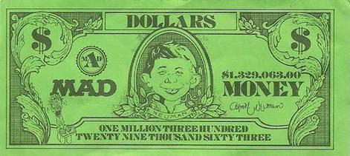
A few comments about Responsibility Centered Management
Became quite popular over last 15-20 years
Implemented in its purest form, it is unworkable
But useful to organize thinking about the budgetary processes in a university
REVENUE GENERATING UNITS – units that generate revenue, most often due to “production of SCHs” – i.e., teaching
SUPPORT UNITS – units that provide support to the Revenue Generating Units, but that do not generate their own revenue.
E.g. IT, Physical Plant, Student Affairs, Libraries, and of course the Offices of the President and the Provost!

Slide 3
Allocating the Budget
In an RCM system, Revenue Generating Units “earn” their budgets (some mix of tuition and legislative appropriation), usually through production of SCHs. This computation is often more complicated than it sounds.
Usually earn different amounts for undergraduate and graduate SCHs. Can vary by discipline and college.
Often an incentive to retain and treat well undergraduate majors
Revenue Generating Units get “taxed” to provide revenue for support units to perform their functions

Slide 4
Advantages and Disadvantages
Units are incentivized to “earn” more money by generating more SCHs (along with other revenues)
Units are incentivized to control their costs, because they keep any excess revenue
BUT
System often fosters competition among units for a finite pool of SCHs
System can be complicated to understand
Quick swings in student behavior/SCH distribution can lead to financial instability
It can encourage perverse behaviors

Slide 5
Even if you do not run under RCM, and even if you do not control your department’s budget
Your dean and provost assess the “value” your department brings to the college and university.
Are you a net generator or consumer of cash? At what levels and by what means?
Gen Ed
Upper division instruction, graduate education
Auxiliary enterprises such as Continuing & Distance Education. If you are a net generator of cash, where does that excess cash go?
How do you compare with other college units? If you are a net consumer of cash, how much at risk are you?
ALL OF THESE QUESTIONS ARE PURELY FINANCIAL AND NEED TO BE BALANCED BY ACADEMIC AND MISSION CONSIDERATIONS.

Slide 6
Why bother with this exercise?
When you have conversations with the dean, they are colored by his perception of your department’s financial and mission-critical contributions in the context of the college. If you understand the department’s situation, you are in a better position to have frank conversations with the dean and to understand some of his motivations and decisions.

Slide 7
Who can help you to understand where your unit lies in the complicated financial ecosystem of your university?
Your department fiscal officer
Your college fiscal officer
Your Institutional Research office

